Slide 1


Predicting Chicago Housing Prices
Conner Cox, Kelci Griffin, Kyle Kohlmeyer, Lindsay McFadyen

Slide 2
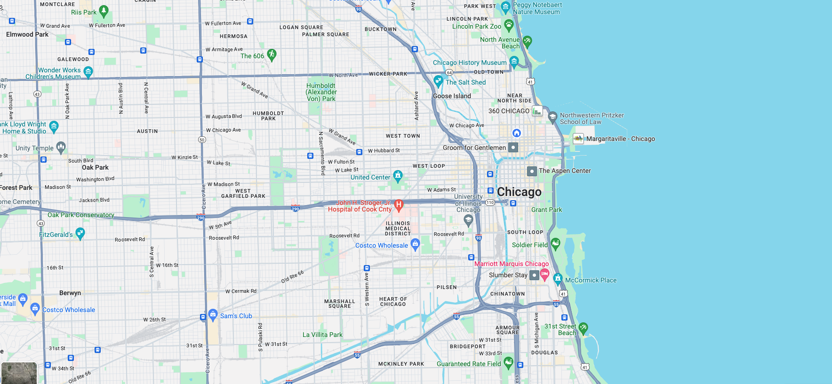
Our project aims to develop and identify the most accurate predictive model for determining residential housing prices in Chicago, leveraging available data on property features and other relevant factors.

Slide 3
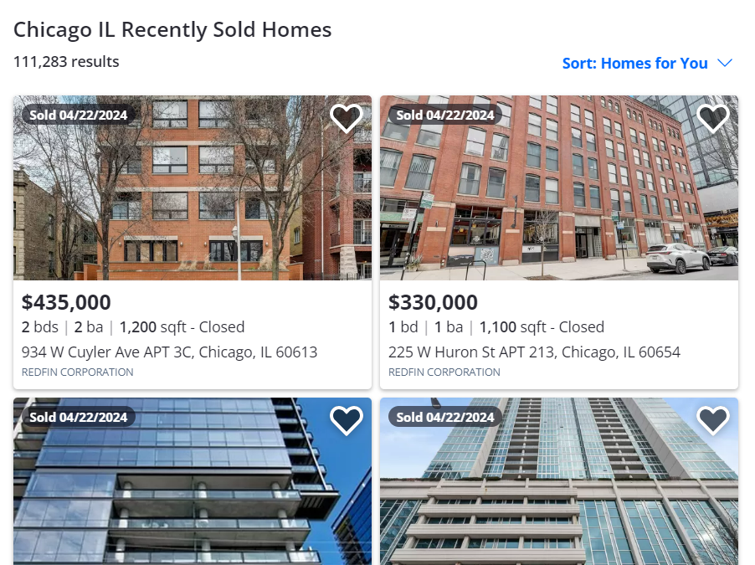

Original Dataset idea: Scrape Zillow
The original plan was to scrape Zillow for the data.
The first two pages were successfully scraped.
Zillow detected the Selenium Headless Browser, pressing the button with no delay.
Zillow (correctly) identified us as a bot and locked us out of the page.
A delay was added, but class tags repeatedly changed.
Our group decided to use the Assessor’s Office data instead.

Slide 4

Data Set from the Cook County Assessor's Office
Data set of residential sales used by the Cook County Assessor in the assessment of residential property values. Contains property information including:
Sale Price, Sale Date.
Property Class, Type of Residence, Apartments, Number of Units.
Wall Material, Roof Material, Rooms, Bedrooms, Basement, Half Baths.
Central Air, Porch, Attic, Fireplaces, Cathedral Ceilings, Garage Material.
Property Square Feet, Building Square Feet, Estimate (Land), Estimate (Building).
Address, Latitude, Longitude, Zip Code.
Cook County Assessor’s Office. (2022). Assessor [Archived 05-11-2022] - Residential Sales Data. Cook County Assessor’s Office Data Department.

Slide 5

Data Cleaning
There were around 2.5 million homes sold, and there was parcel data for over 30 million properties in the Cook County assessor's dataset
Some unnecessary census information was dropped directly on the assessors website before download
The parcel data was downloaded as eight separate files, and each file was inner-joined to the sold homes dataset to produce eight dataframes of joined data.
The eight data frames were then concatenated together to produce joined_data_df, which was still very large and difficult to work with.
Additional columns were dropped and the sales were narrowed to 2018 and 2019, creating a more manageable dataset to work with

Slide 6
Logistic Classification Model (Kyle)
Limits: Include Single Family homes greater than $100,000 andr $1,000,000.
Estimated Total = Estimated (Land) + Estimated (Building)
Price Difference = Sale Price - Estimated Total
Sale Outcome = Price Difference / Estimated Total
Y = Sale Outcome
X = Features: Property Class, Neighborhood Code, Town Code, Type of Residence, Basement Finish, Central Heating, Attic Type, Garage 1 Size, Garage 1 Attachment, Garage 1 Area, Porch, Use, Zip Code, Ward Number, School District Name, Nearest CTA Route Name.
≈
Training Data Score: 0.613
Testing Data Score: 0.592
Classification Report
 | Precision | Recall | f1-Score | Support
False | 0.56 | 0.59 | 0.58 | 434
True | 0.62 | 0.59 | 0.6 | 434
Accuracy |  |  | 0.59 | 918
Macro Avg | 0.59 | 0.59 | 0.59 | 918
Weighted Avg | 0.59 | 0.59 | 0.59 | 918

Slide 7
Random Forest Regression Model (Kyle)
Limits: Include homes greater than $100,000 and less than $1,000,000.
Y = Sale Price
X = Features: Property Class, Neighborhood Code, Town Code, Type of Residence, Basement Finish, Central Heating, Attic Type, Garage 1 Size, Garage 1 Attachment, Garage 1 Area, Porch, Use, Zip Code, Ward Number, School District Name, Nearest CTA Route Name
Mean Absolute Error: $60,415.25
Root Mean Squared Error: $84,340.18
≈
Prediction | Actual
$282,450.00 | $272,400
$272,765.87 | $375,900
$173,076.91 | $105,000
$353,301.72 | $540,000
$158,834.47 | $165,000
$282,161.90 | $250,000
$296,925.46 | $182,500
$337,399.77 | $250,000
$177,397.12 | $171,000
$323,175.43 | $213,000

Slide 8
Random Forest Regression Model (Kelci)
Y = Sale Price (> $50,000)
X = Features: Bedrooms, Basements, Central Air, Half Baths, Porch, Building sq ft., Estimate (Land), Estimate (Building), Full Baths, Sale Year. Property Class
Mean Absolute Error: $83,749.89
Root Mean Squared Error: $155,303.34
Prediction | Actual
$132,696.88 | $145,000
$542,624.24 | $295,000
$109,249.62 | $89,280
$150,238.30 | $85,000
$1,319,620.64 | $1,481,000
$796,522.75 | $690,000
$277,728.70 | $215,000
$447,408.91 | $363,000
$191,476.52 | $487,000
$583,732.35 | $428,000

Slide 9
Random Forest Regression Model (Conner)
Limits = Include only single family homes with sale prices greater than $200,000 and less than $750,000.
Y = Sale Price
X = Latitude, Longitude, Sale date.
Mean Absolute Error: $70,742.08
Root Mean Squared Error: $97,432.49
Prediction | Actual
$291,515.00 | $210,000
$383,540.00 | $395,000
$213,048.00 | $205,000
$221,740.00 | $206,000
$230,789.00 | $218,000
$450,875.00 | $275,000
$269,368.00 | $235,000
$228,414.85 | $214,000
$358,235.00 | $450,000
$285,290.00 | $212,000

Slide 10
Regression Class Codes
One-story Residence, any age, up to 999 sq. ft.
One-story Residence, any age, 1,000 to 1,800 sq. ft.
One-story Residence, any age, 1,801 sq. ft. and over
Two-or-more story residence, over 62 years of age up to 2,200 sq. ft.
Two-or-more story residence, over 62 years of age, 2,201 to 4,9999 sq. ft.
Two-or-more story residence, up to 62 years of age, and up to 2,000 sq. ft.
Two-or-more story residence, up to 62 years of age, 3,801 to 4,999 sq. ft.
Two-or-more story residence, any age, 5,000 sq. ft. and over
Split level residence with a lower level below grade (ground level) all ages, all sizes
Two-or-more story residence, up to 62 years of age, 2,001 to 3,800 sq. ft.
Individually owned townhome or row house up to 62 years of age

Slide 11
Random Forest Regression Model with Sq. Ft. (Conner)
Limits = Include only single family residences with sale prices greater than $200,000 and less than $750,000.
Y = Sale Price
X = Latitude, Longitude, Sale date, Building Sq. Ft.
Mean Absolute Error: $60,180.54
Root Mean Squared Error: $83,056.65
Prediction | Actual
$290, 539.52 | $210,000
$423,389.26 | $395,000
$217,639.00 | $205,000
$226,974.00 | $206,000
$245,499.00 | $218,000
$453,908.00 | $275,000
$253,350.00 | $235,000
$228,792.68 | $214,000
$309,636.00 | $450,000
$267,007.50 | $212,000

Slide 12
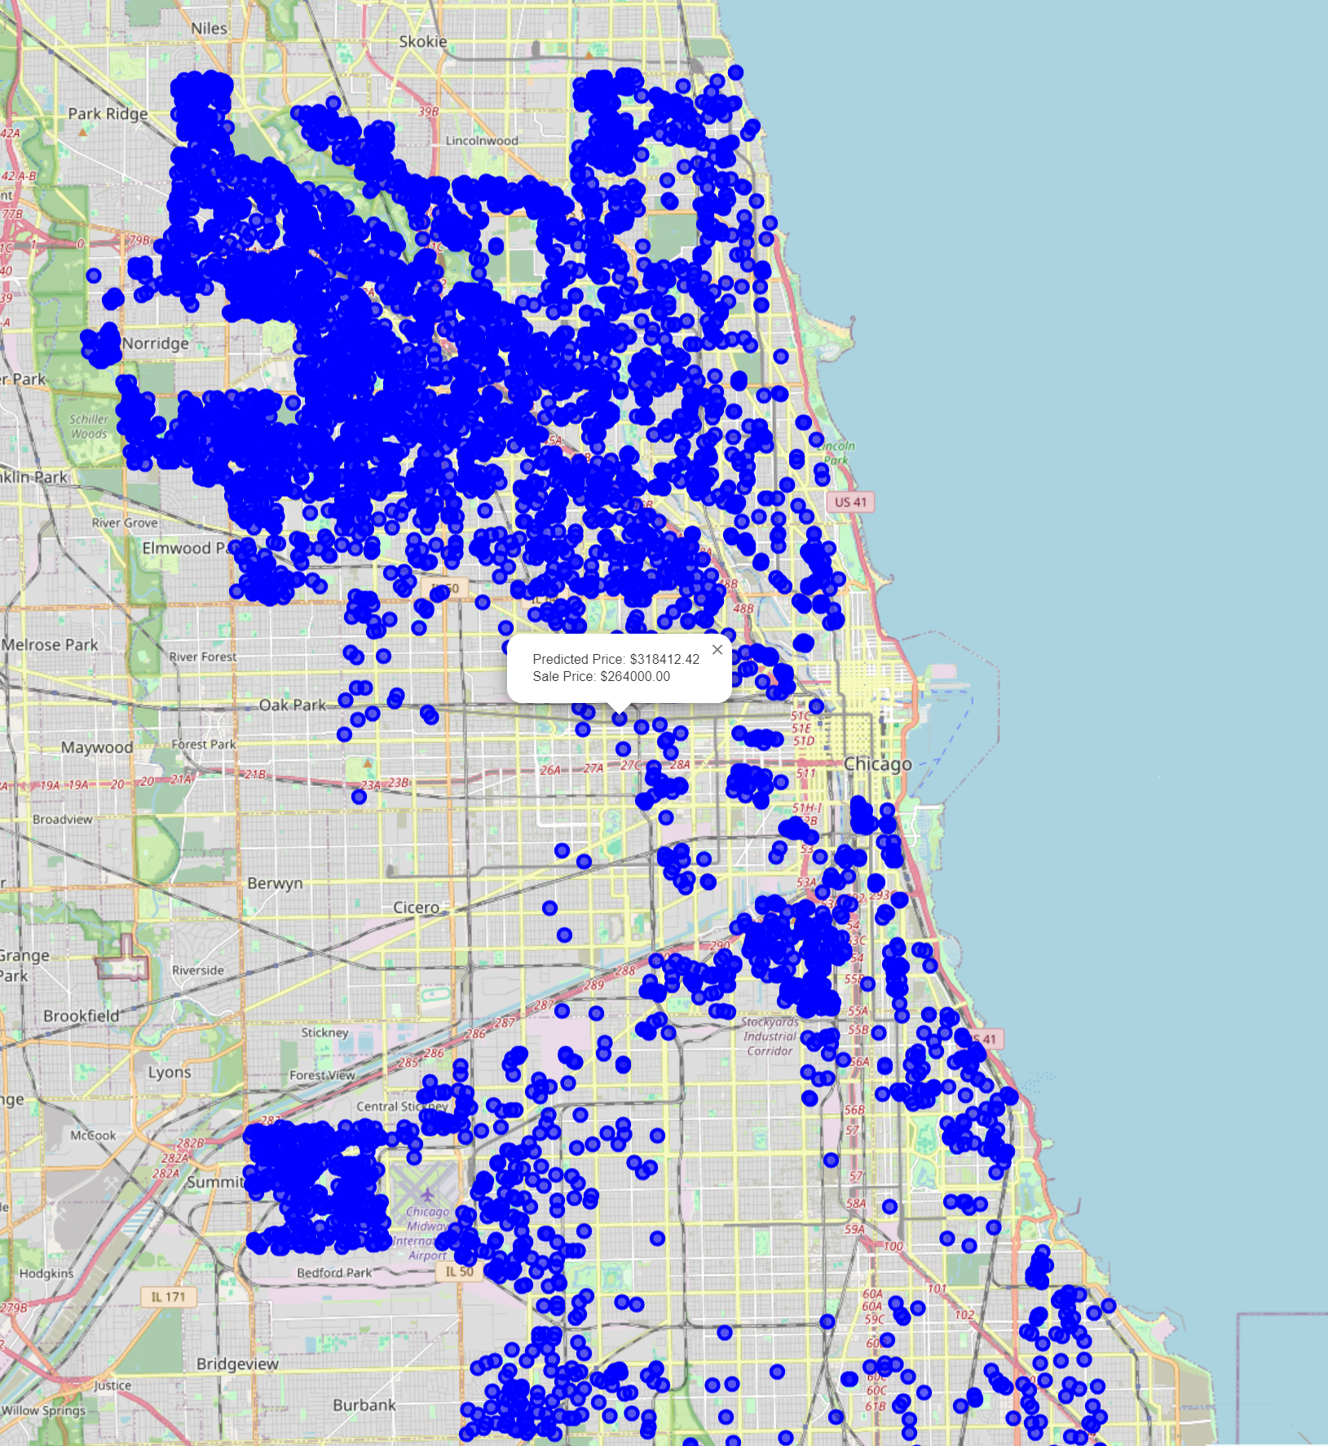
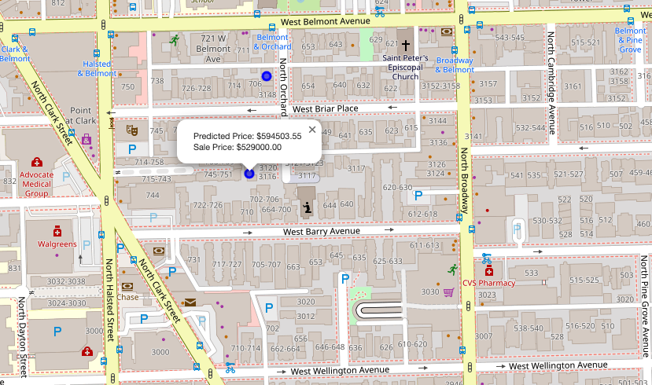
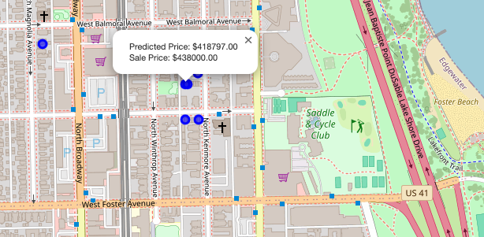
Mapping Chicago Housing Price Predictions
https://connercox1112.github.io/Folium_Visualization/

Slide 13
Outcome
Connor’s Random Forest Regression Model had the most accurate model to predict housing prices.
Y = Sale Price
X = Latitude, Longitude, Sale date, Building Sq. Ft.
Mean Absolute Error: $60,180.54
Root Mean Squared Error: $83,056.65
The model's success can be attributed to the strategic limitation of the dataset to include only sale prices between $200,000 and $750,000 and single family residential properties.
Additionally, the model used data from home transactions occurring from 2013 to 2019. While, the other models only utilized transaction data from 2018 to 2019.

Slide 14
Recommendations for Future Research
Limitations
Accuracy of sale price.
Only one sale price per home within data set.
Lack of variables to account for market factors.
Rising interest rates after pandemic.
Aggregate housing predictions by neighborhood and incorporate census demographics including income and race to identify neighborhoods at risk for lack of affordable housing and gentrification.
Create a single or multiple linear regression model which uses one or more independent variable to predict a dependent variable.

